Slide 1
Multimodal Learning and Single Source Wi-Fi based Indoor Localization
Hongyu Wu
Department of Electrical & Computer Engineering
University of Dayton
wuh007@udayton.edu
Advisor: Dr. Feng Ye
Committee:
Dr. Vijayan Asari
Dr. Bradley Ratliff
Apr. 16, 2020
１
Notes:
Good afternoon, everyone, thanks for coming. My name is Hongyu Wu. Today I am going to defend my thesis. The topic of my thesis is Multimodal Learning and Single Source Wi-Fi based Indoor Localization
.

Slide 2
Table of Contents
Introduction of Indoor Localization
Motivation of the research work
Proposed Multimodal Learning and Single Source Wi-Fi Localization
Video based Localization Data Labeling
Single Source Wi-Fi based Localization
LSTM based Path Tracking
Conclusion and Future Work
２
Notes:
Here is the table of contents: I will follow the list to present my thesis. I will firstly give a brief introduction of indoor localization system, and then get to the motivation of the research work. After that, I will introduce the proposed multimodal learning and single source Wi-Fi localization system step by step. The Final section will be conclusion and future work.

Slide 3
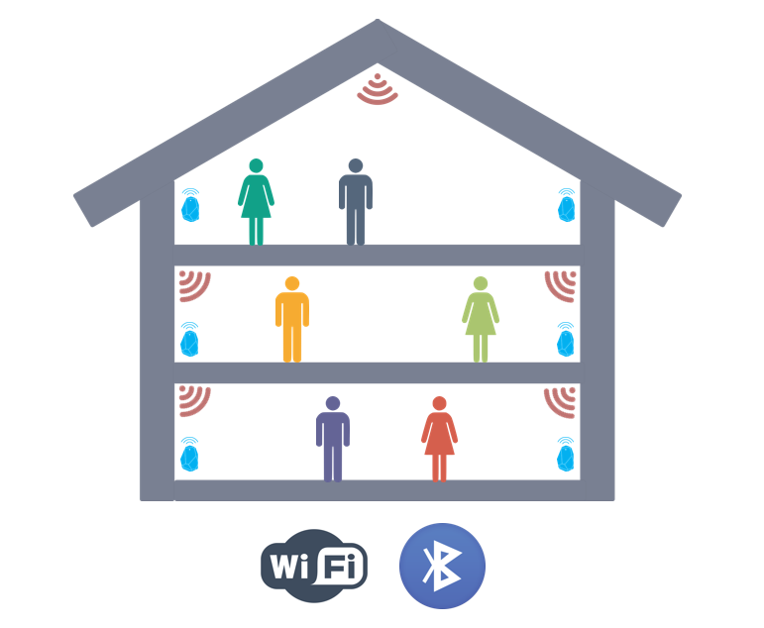
Indoor Localization
A process of tracking people or objects
relative to indoor environment
Addressed the drawbacks of GPS and
other statellite technologies
Broadly applied in commercial,
military, hospital, etc
https://pigeon.srisys.com/blog/types-of-indoor-positioning-systems/
３
Notes:
indoor localization is a process of tracking people or objects relative to indoor environment. It addressed the drawbacks of GPS and
other satellite technologies. As we all knows, GPS is using microwave to localize the object, however, the microwave can be easily affected by the solid object such as the roof or walls of a building. So, to deal with that, indoor localization techniques are coming out and broadly applied in the areas of commercial, military, hospital, etc. For example, it is pretty useful for a doctor gives treatment to a patient on time by knowing where the patient is in a hospital , especially during this period.

Slide 4
Indoor Localization Techniques
Optical-image based:
- Light pulses or intensity
- High cost and low coverage
Signal-wave based:
- Mixing source signal based on various signal metrics
４
Notes:
The indoor localization techniques can be briefly categorized into two types: optical-image based and signal wave based.
the optical image based method utilize infrared tech and image processing tech to capture the light pulses or intensity. However, this method always comes with a high cost because of the expensive equipment that are required, and the image coverage is always lower than signal coverage. So, the signal wave based method is now the most popular indoor localization technique used in market. it basically achieves the localization by analyzing mixing source signal(sound, radio frequency, etc) based on various signal metrics.

Slide 5
Signal-wave based Indoor Localization Techniques
Log-distance propagation based method
- Distance between transmitters and access points
- Devices Limitation and Interference
Fingerprinting based method
- Offline training
- Online Localization
- Wi-Fi
５
Notes:
Within the signal based indoor localization techniques, log-distance propagation based method are widely used. it calculate distance between transmitters and a number of access points in a facility. one popular technique is called Time Difference of Arrival(TDOA) TDOA is using signal transimittig time and speed to calculate the distance. however, this kind of method requires at least three devices and localization system can be easily affected by the interference.
Therefore, fingerprinting based method is now apealling more attention by researchers and engineers.
Fingerprinting based method is comprised of two phases: offline training and online localization. In the offline training phase, a site survey is conducted to generate a radio map of signal measurements from different locations in an indoor environment. Then, the localization model of the system is constructed based on the collected fingerprints. When it comes to the online localization phase, the real-time measurements are compared with the radio map to estimate the user location. Furthermore, since Wi-FI is the most commonly used signal source in the world, plus widespread internet connected devices, it becomes the best option for indoor localization by providing efficient and low cost infrastructure.

Slide 6

Motivation of the research work
Time-consuming & laber intensive fingerprint database construction
The stability issue due to the sensitivity to environmental changes
Mostly rely on multiple Wi-Fi sources
https://www.payetteforward.com/my-iphone-location-is-wrong-heres-fix/
６
Notes:
Although Wi-Fi based indoor localization is regarded as a promising method for indoor localization, it still has a few problems: Firstly, building a fingerprint database is
a time-consuming and labor-intensive process which involves a large amount of time and
money expense. Secondly, the stability of localization system can easily be affected by environmental changes, as a result, it can lead to really inaccurate localization, especially for long-
term deployment. So, In order to maintain the precision of the localization system, we will need to frequently
re-collect the fingerprints and updating the localization system.
Finally, to achieve a relatively accurate localization, current Wi-Fi fingerprint based local-
ization methods usually rely on multiple Wi-Fi sources which will inevitably bring up the
cost. Therefore, automating the construction and update
of fingerprint database, achieving a high accuracy localization, and meanwhile maintaining
the cost of system, are necessary to tackle the current situation.

Slide 7
Overview of Proposed Indoor Localization System
Video based Localization Data Labeling
Single Source Wi-Fi based Localization
LSTM based Path Tracking
Proposed Multimodal Learning and Single Source Wi-Fi Localization
７
Notes:
Next, we will get in detailed about the proposed multimodal learning and single source Wi-
Fi based indoor localization system. we will firstly have a overview of proposed system, and get further into each section.

Slide 8
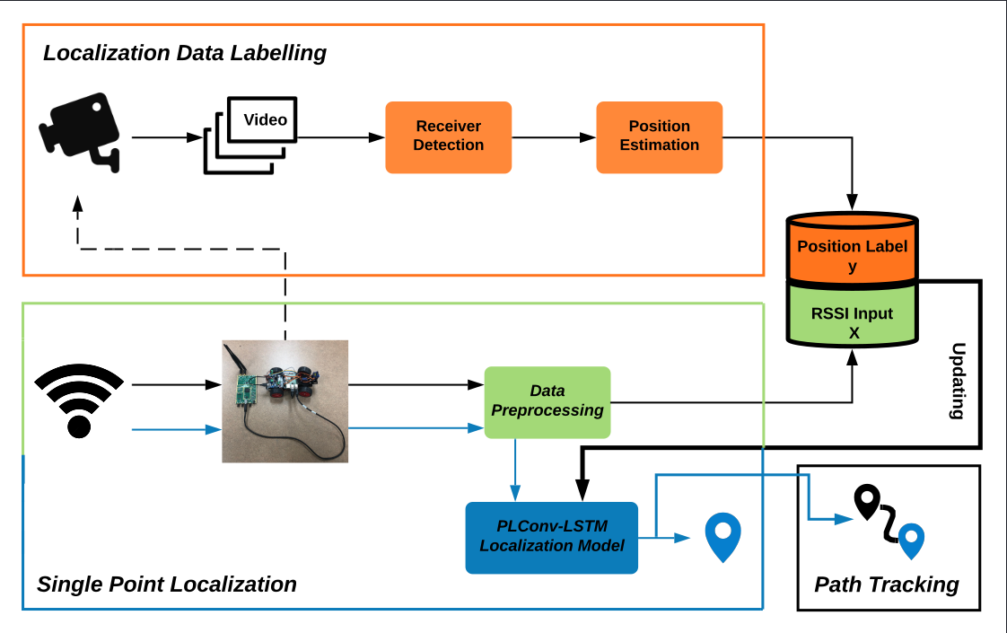
Overview of Proposed Indoor Localization System
８
Notes:
This is the overview of the proposed Indoor Localization System. The system consists of three major components, including a video
based localization data labelling section, a single point Wi-Fi based localization section, and a case study section of receiver path tracking based on proposed localization scheme.
The localization data labelling section involves two parts: Firstly, a com-
puter vision based object detection part that builds a self-driven signal receiver and detects
the existence and postion of the receiver in a video in real time. Secondly, an autonomous labelling part
that transforms the view angle of the camera to a two dimensional view, and estimate the
position label of receiver in orginal video based on the real world scale, denoted as y.
The single point Wi-Fi based localization section includes preprocessing the collected signal from single Wi-Fi transmitter and deriving the Received
Signal Strength (RSS) based input data, denoted as X . By combining X with its corre-
sponding y, the offline database for localization model can be con-
structed and updated autonomously. Moreover, in this section we cover the design of proposed deep learning based localization model, which will classify the receiving signal into its corresponding location.
We also proposed an optimization method to improve localization performnce. Lastly, Based on proposed indoor localization scheme, a case study of path tracking section is proposed
that aims to build a possible indoor navigation application. An path
tracing algorithm is explained and evalueted.

Slide 9
Hardware Setup
Signal Receiver Detection
Receiver Position Estimation
Video based Localization Data Labeling
９
Notes:
FIrstly, we will get into the video based localiation data labeling section, it includes:

Slide 10
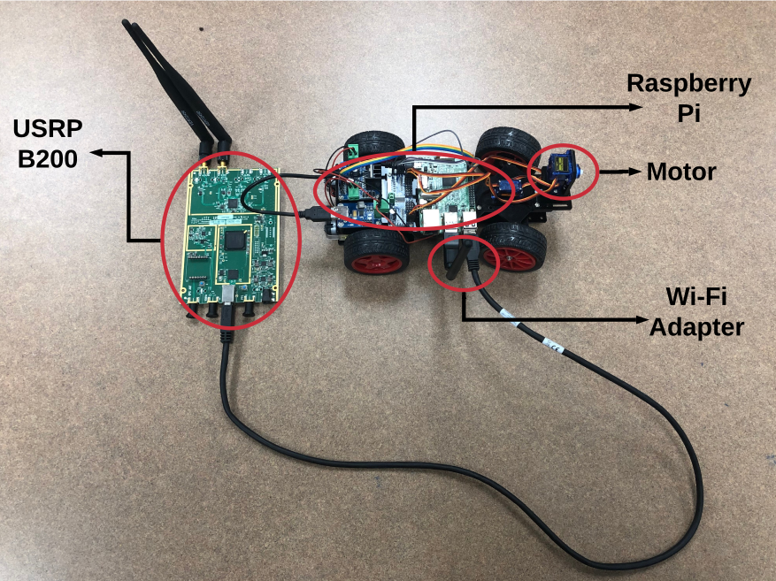
Video based Localization Data Labeling
Hardware Setup
WiFi remote control.
Real-time signal collection.
１０
Notes:
To initialize the video
based location data labeling section, a self-driven robocar is firstly built by assembling and
programming a Raspberry Pi microcontroller board with power-controlled motors, wheels,
and a Wi-Fi adapter. In addition, an USRP B200 SDR board is connected to the robocar
to extend the robocar with the function signal collection. In an real application scene, instructions will be
sent from the console to the self-driven signal receiver through the Wi-Fi, which guides the self-driven receiver running
and collecting signal information in an indoor environment
By utilizing the constructed remote controlled signal
receiver, the data preparation process of localization fingerprint database can be achieved
automatically without much human resources.

Slide 11
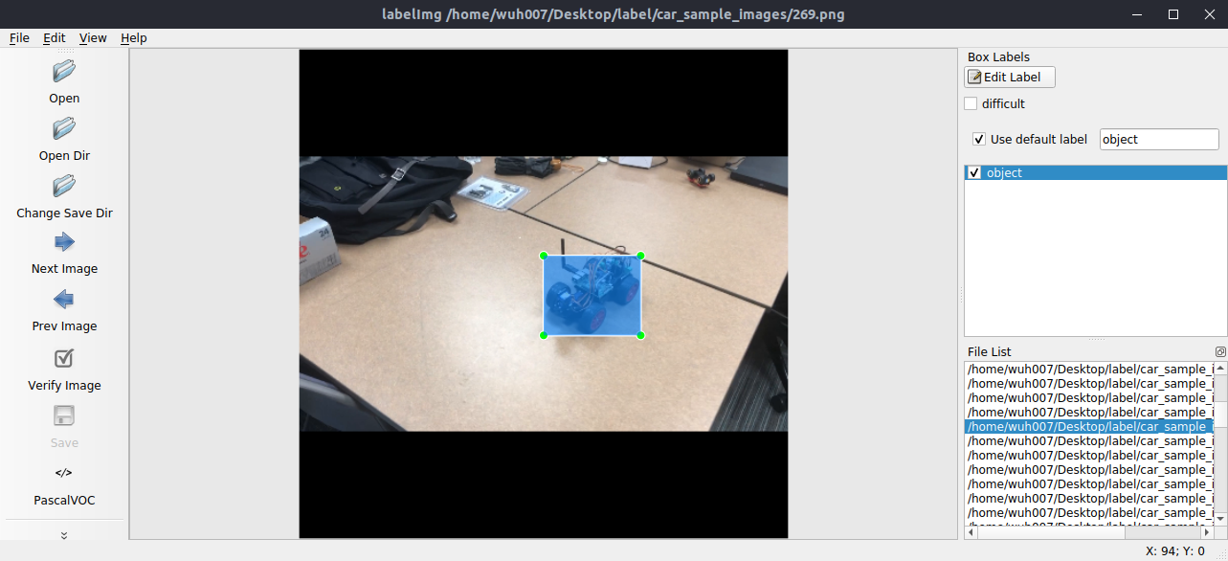
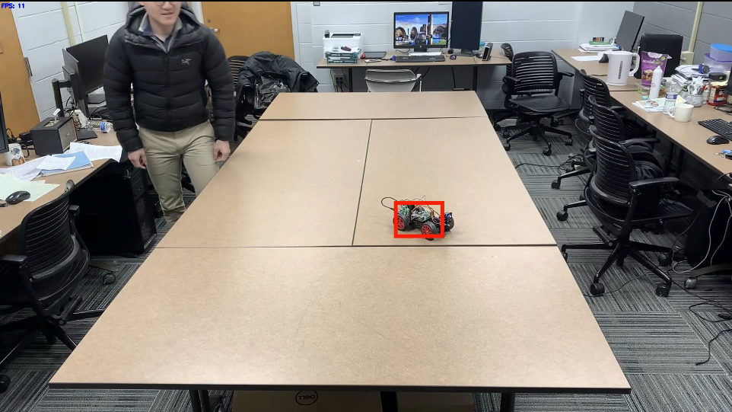
Video based Localization Data Labeling
Signal Receiver Detection
Object Detection Algorithm(YOLOv3).
Training data labeling.
Real-time receiver detection.
１１
Notes:
in computer vision, video based object detection is now becoming a fundamental building block
for vision-enabled autonomous systems which helps find the objectness in two dimensional
images. In order to obtain the position label of the localization fingerprint database, a computer
vision based signal receiver detection algorithm is implemented. To determine the objectness of signal
receiver in a real-time video, YOLO
is applied due to its robustness and fast speed.
“YOLO detects object by spliting an image into several
grids. By applying convolutional operation to extract the latent features in each block of
the image, the feature map that “
the output of such object detection algorithm contains the bounding box coordi-
nates, the objectness score, and the class score. Here we only focus the bounding box and objectness score since in this research we only want to find the existence of the signal receiver. In addition, YOLOv3, which is the newest version of YOLO, performs greatly
even in small object detection and runs in a fast speed without losing its stability comparing to previous versions
in oreder to accurately detect the self-driven signal receiver existing in an image, a well trained
YOLOv3 network is desired. In this research work, hunderds of images contains the signal
receiver are taken from different distances and angles. Those images are later labelled as the
training dataset for the YOLOv3 object detection network. A sample of labelled training
dataset is shown on the top right. Besides, a cell phone camera is mounted at a top corner of an
indoor environment, to simulate the surveilance camera in real life. a frame of test result of the well-trained object detection network.

Slide 12
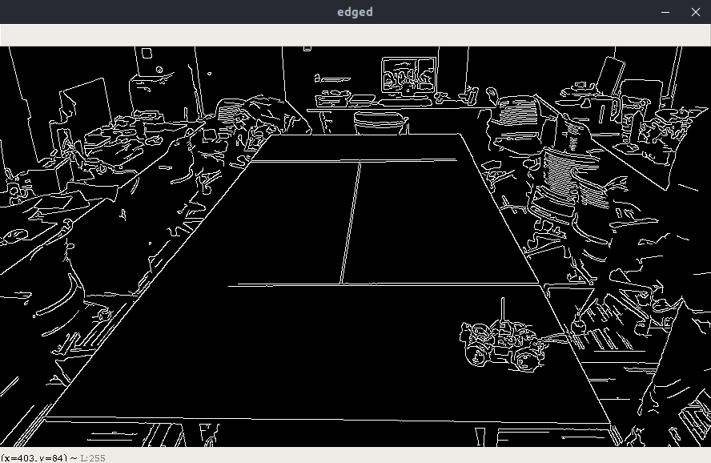
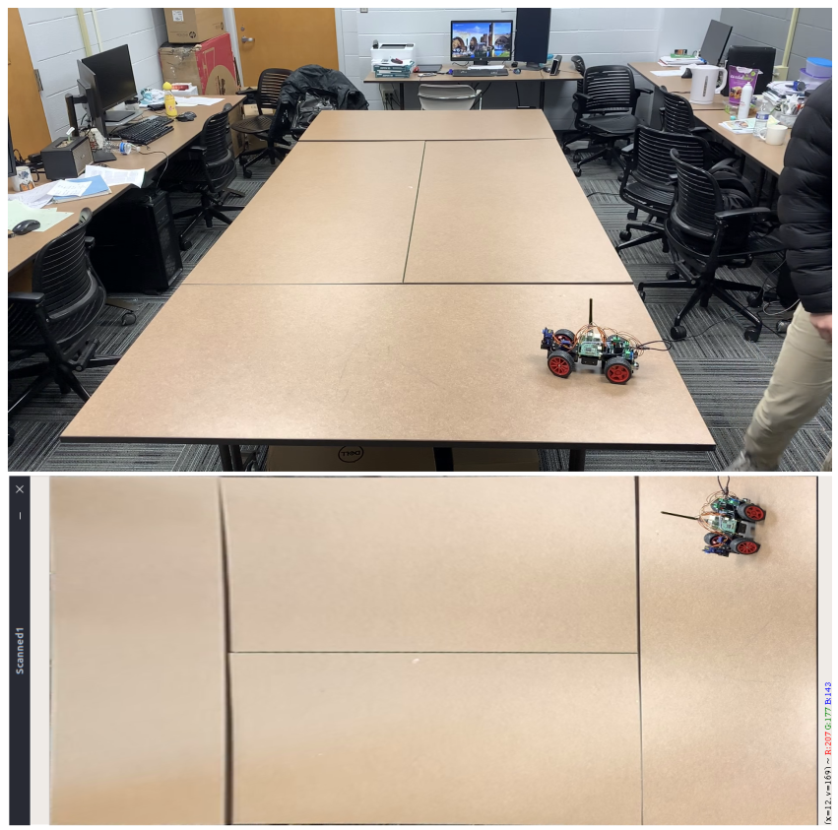
Video based Localization Data Labeling
Receiver Position Estimation
i. Canny Edge Detection. ii. Perspective Transformation.
１２
Notes:
in this research work, we assume the table area is the detected indoor area. To automat-
ically find the range of detection indoor area in that frame, a technique called canny edge
detection is used, which can detect a wide range of edges in images. The biggest area enclosed
by detected edges can be therefore computed and selected as the detection area.
also, The perspective transformation,
also known as homographic mapping, turns the projection of specfied area of an image into
a new visual plane is used. By applying perspective transform algorithm to the original image with
known edges of detected indoor area, as well as the aspect
ratio of such area in real-world coordinator, a top-down, ‘birds-eye view’ of the detected area can
be obtained

Slide 13
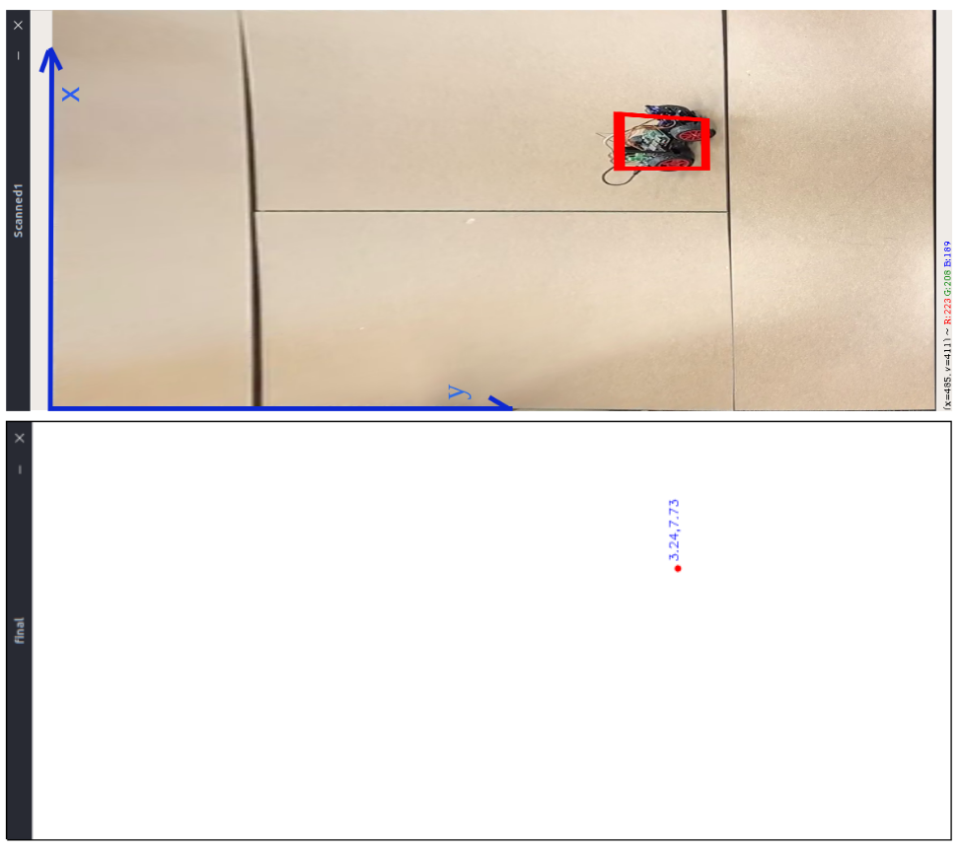
Video based Localization Data Labeling
Receiver Position Estimation
i. View plane transformation. ii. Real ratio conversion.
１３
Notes:
Comparing transformed visual plane with the true plane in real-world coordinator, the
proportion is maintained. Therefore, the transformed visual plane is considered as a scaled
projection of the detection area. Based on the previous steps, we assume the transformed middle point of detected
bounding box in new visual plane as the location of the object or receiver. Therefore, a
new double-polar coordinate system is established with x-y axises. By calculating the ratio of x-y coordinates pixel value regarding to the width and height, which is 5X11feet
of the transformed plan, the real position of the detected object can be estimated. The estimated position is
converted to position label in next phase and and used as one significant portion of dataset
to establish the localization fingerprint database.

Slide 14
Single Source Wi-Fi Signal Collection
Signal Data Preprocessing
Parallel Learning Convolutional Long Short Term Memory Network for Localization
Adaptive Thresholded & Stacked Voting Scheme
Evaluation Results
Single Source Wi-Fi based Localization
１４
Notes:
Next, we will get in detailed about the proposed single source Wi-
Fi based indoor localization system.

Slide 15
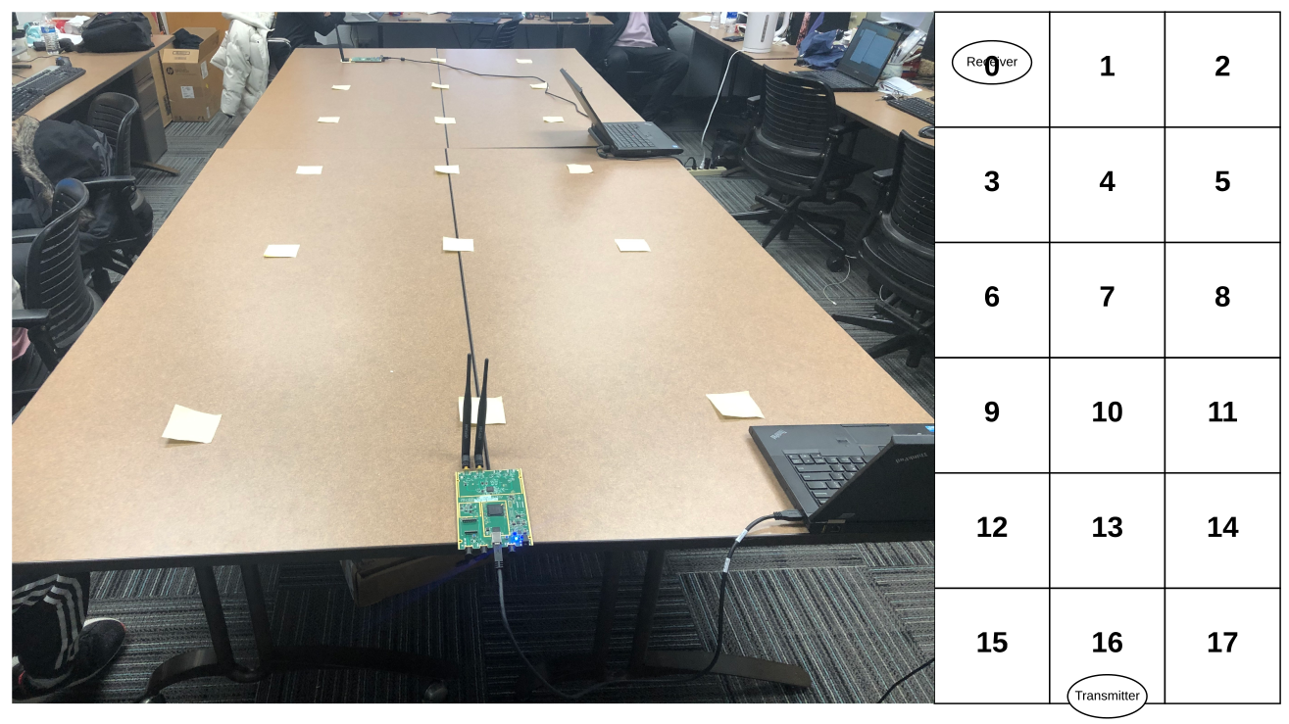
Single Source Wi-Fi based Localization
Single Source Wi-Fi Signal Collection
i. Research Environment
- 5 x 11 ft² table to 18 sections
ii. Hardware Settings
Two USRP b200 connected to two laptops through USB port.
Receiver for RSS sensing
Wi-Fi transmitter (F_{c} = 5.17GHz, BW = 20MHz)
Collecting 2-3mins to build the offline database
iii. Software Settings
GNU Radio software development toolkit
Python 2.7
１５
Notes:
The data collection processs is conducted on the surface of the table. The surface
area is firstly divided into 18 sections with an equal size. The estimated receiver position is
then converted into the section label. The self-driven signal receiver is
placed on each section to collect signal data. Another USRP B200 board is placed at a fixed
place of the experimental area to perform as transimitter which enhance the signal feature
in the room. The trasmitting center frequency is set to 5.17 GHz, with a bandwidth of
20 M Hz, to simulate a 5 GHz Wi-Fi band. The transmitter is set to keep propogating
the signal to surrounding environment. Meanwhile, for the receiver, the receiving frequency
range is set to the correspoding center frequency (5.17 GHz) and bandwidth (20 M Hz), in
order to measure the entire spectrum of the transmitting signal. The fingerprint dataset for
localization model contains the measured signal information and its corresponding receiver
position label. To obtain enough fingerprints from the experimental area, the self-driven
signal receiver is set to traverse all sections and stay for around 3 minutes at each section.
In addition, without loss of generality, two sets of data are measured on two different
days.

Slide 16
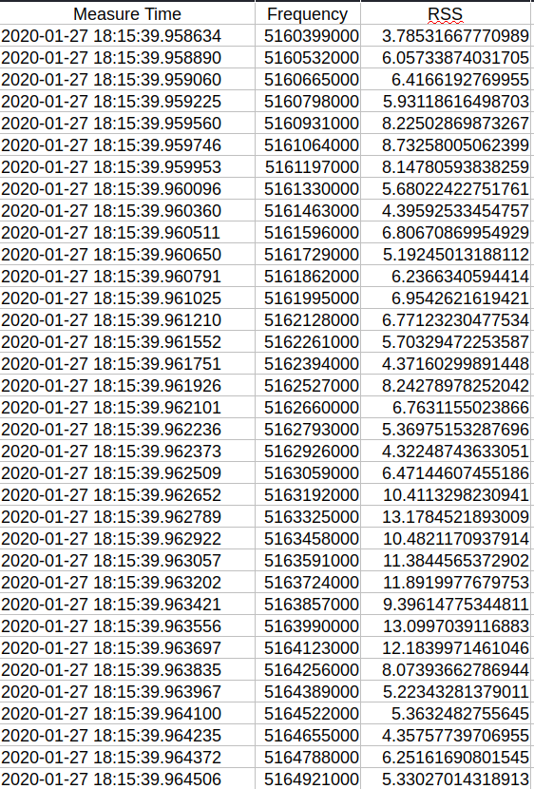
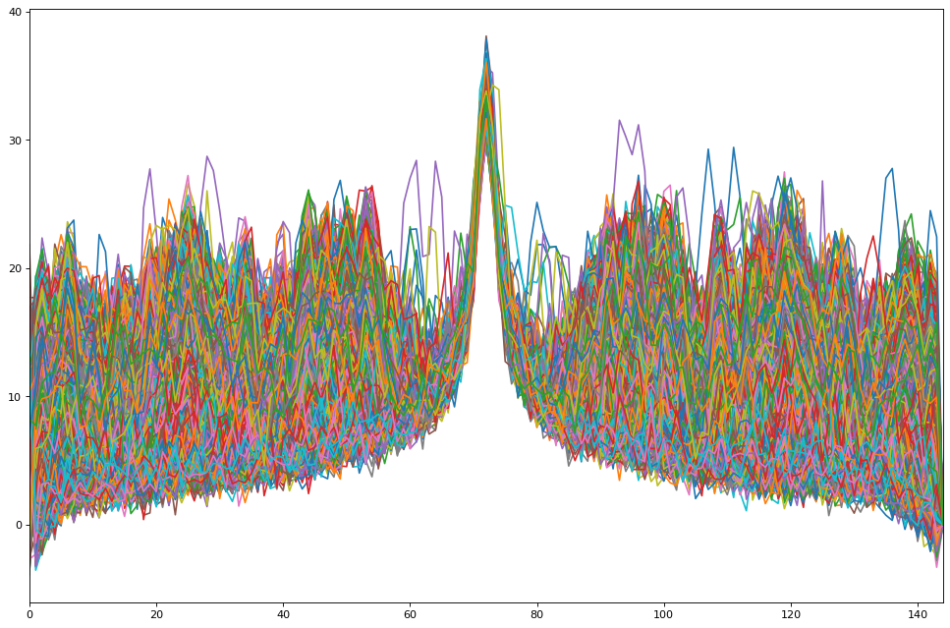
Single Source Wi-Fi based Localization
Single Source Wi-Fi Signal Collection
i. Each dataset:
- 144 RSS measurements at different frequency step between 5.17 GHz ± 10 M Hz, with a same fequency
and time interval.
ii. collection speed:
- 5 - 10 sets of data per second.
iii. collected data:
- 940 per section, 16922 in total
rss
5.16GHz to 5.18GHz
１６
Notes:
In this research work, each set of data contains the received signal strength at 144 frequency
steps across the spectrum that is being measured. That is saying, 144 measurements are
taken at different frequency step between 5.17 GHz ± 10 M Hz, with a same fequency
and time interval. In additon, the signal receiver is able to collect at least 5 sets of data
per second. For each section in experimental area, 940 datasets are measured in around 3
minutes, and a total of 16922 datasets are obtained from 18 sections. A sample of collected
RSS data by signal receiver is shown in the pircture.

Slide 17
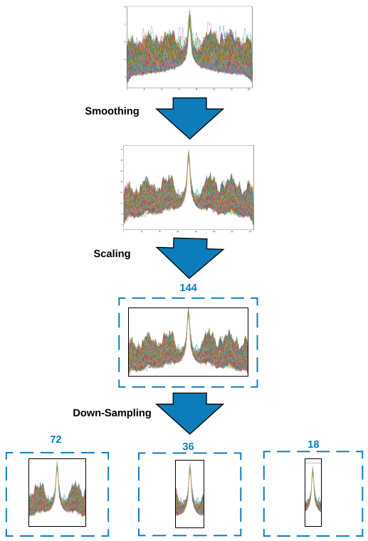
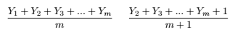
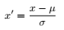
Single Source Wi-Fi based Localization
Signal Data Preprocessing
i. Smoothing and Denoising
- Moving Average Method. m = 5
ii. Data Standardization
- Standard Scaler
iii. Multi-scale Down-sampling
- Down-sampling coefficient
of 0.5, ( 144, 72, 36, 18)
- Trim the head and tail
１７
Notes:
Data preprocessing is a extremely significatnt process that allows improving the quality
of the raw experimental data. here we introduce three preprocessing methods we used in this
research work, smoothing and denoising, data standardization, as well as multi-scale down
sampling. Smoothing and Denoising, means removing unwanted spikes, trends and outliers from
a signal. Moving average method, is one of
the most well-known filters is applied because of its effectiveness. Moving average method can effectively
eliminate the short-term fluctuations of the signal data. Given a set of time series numerical values Y 1 , Y 2 , Y 3 , ... Yn corresponding to time
steps t 1 , t 2 , t 3 , ... t n , where n indicates the total size of the sampling time steps. Assume
the order of moving average is m, it can be calculated by the sequence of arithmetic means.
In this research work, according to the experimental results, the moving averages of order
5 is selected, which means that the moving average window will compute the average of the
beginning five sets of raw data and form the first set of smoothed data.
Then the average
of second set to sixth set of raw data will be calculated
Although the raw
data is initially smoothed and denoised by the method of moving average, the step of data
normalization is necessary for feature engineering. In the case of time series signal data, the
fructuation happens frequently due to the effect of surrounding environment. Therefore, if
a single value of the feature is orders of magnitude greater than other values of the feature,
that particular value might dominate others in the dataset and affect the performance of
localization model. In this research work, the standard scaler is adopt to transform the data. The standard
scaler centers the data by removing the mean value of the feature and then scale it by
dividing features by their standard deviation, the equation is as follows.
For every time series data, the long-term features reflects overall trends and short-term
features depicts more detailed changes in local regions. Times series data in different scales
will potentially affects the distinction of features when performing the classification task.
Therefore, in order to capture temporal patterns existing in the time series signal data,
various down-sampling coefficients are applied to further consolidates information about
the time series featrues on a smaller time scale.In this research work, three different scales are used with a down-sampling coefficient
of 0.5, which means that 144 time steps of preprocessed smoothed data are down-scale to
72, 36, and 18, respectively. It is noted that the proposed down-sampling method trims
the front and end of the original data, due to the stablity and distinction of features near
the center frequency, according to the experimentes.

Slide 18
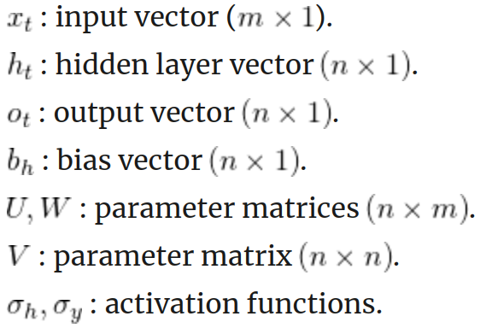
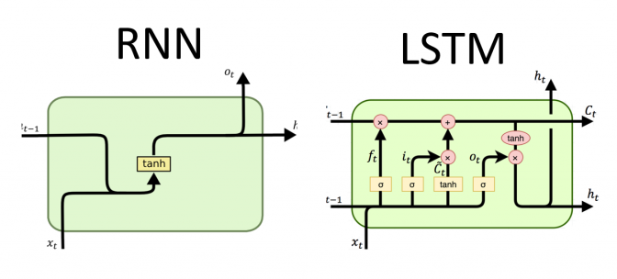
Single Source Wi-Fi based Localization
Parallel Learning Convolutional Long Short Term Memory Network for Localization
i. Preliminaries
- RNN
feedforward neural network with internal memory
- LSTM
input, forget, cell, output, hidden gate
http://dprogrammer.org/rnn-lstm-gru
１８
Notes:
Here we have already finished the construction of fingerprint database with position labels and preprocessed signal data,
Next, we will dicuss the design of our deep learning based localization model. Here are a few preliminaries.
Recurrent Neural Network is a generalization of feedforward neural network that has an
internal memory [45]. RNN performs the recurrent function for every input of data while the
output of the current input of data is affected by the last output of the past computation.
In other word, in a standard RNN, the decision of every time step depends on the decision
made by the previous time step. Therefore, unlike other neural networks, all the inputs in
a RNN are related to each other, which makes it a excellent architecture for analyzing time
series data. However, RNN often encounters Gradient vanishing and exploding problems
due to its short-term memory unit. To overcome this issue, Long Short Term Memory Recurrent Neural Networks are pro-
posed, which is an improvement over the general RNN by incorporating several gating functions
into their state dynamics and integrating the long-term memory unit.
“When a new input comes in, its information
will be accumulated to the memory unit if the input gate i t is activated. In addition, the
forget gate f t controls if the past memory state m t − 1 needs to be ”forgotten”. Besides,
the output gate o t will further controls if the current memory state m t will be forwarded
to the hidden state h t “.

Slide 19
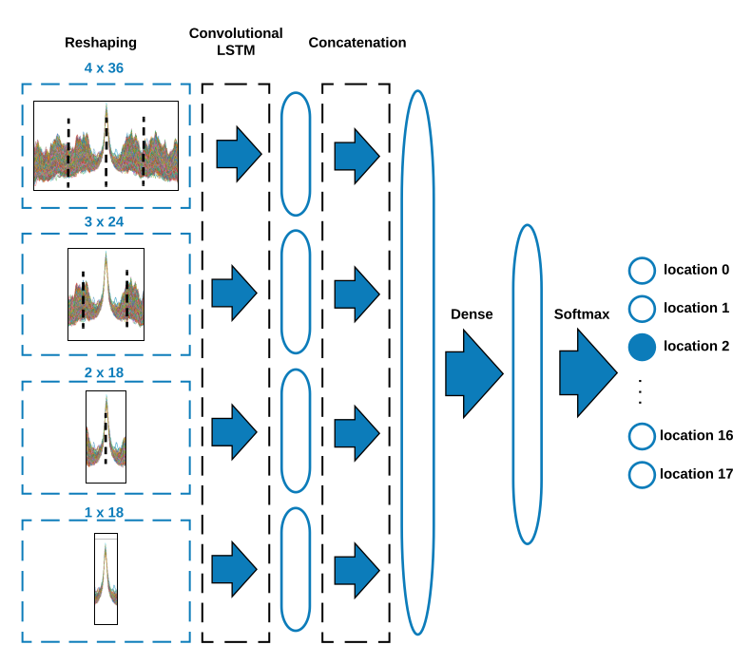
Single Source Wi-Fi based Localization
Parallel Learning Convolutional Long Short Term Memory Network for Localization
ii. Proposed PLConv-LSTM Localization Model
- Multiscale signal data reshaped as inputs
- Conv-LSTM network
- Concatenation
- Dense + Classification
１９
Notes:
Here we come to the design of our deep learning based localization model, which is called PLConvLSTM
we ultilized an advanced LSTM network called convlstm,
convolutional lstm extends the traditional LSTM with convolutional layers and is able to extract the spatiotemporal features
in time series data.
After down sampling, multiple time series with different length from a smoothed time
series are generated. In order to feed data into the convolutional LSTM, we reshape each
time series into sepecific sized data points. As with a CNN or LSTM network, the output
of convolutional LSTM is concatenated and flatten into a long vector that contains all the
extracted spatiotemporal features. Those feature are compressed with a dense layer and
finally output by the output layer with a Softmax function.
the Softmax function normalizes an input vector into a series of probabilistic
values that the input data has probabilities to be any one class among the all, and the
sum of those probabilities is 1.For instance, the incoming signal will be classified into one of 18 locations, where the predicted location has
the maximum probability value within all locations.

Slide 20
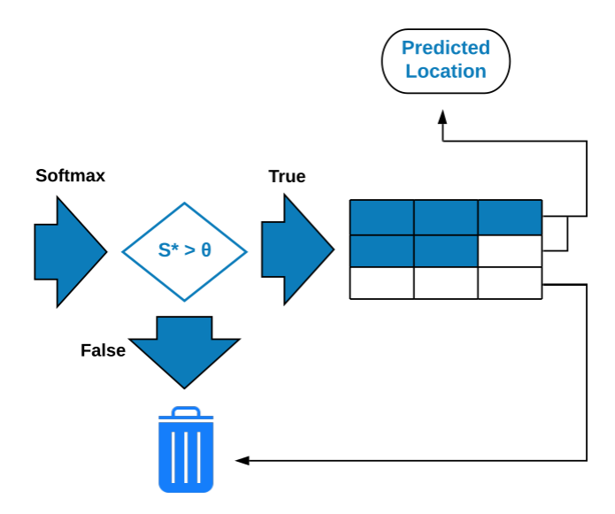
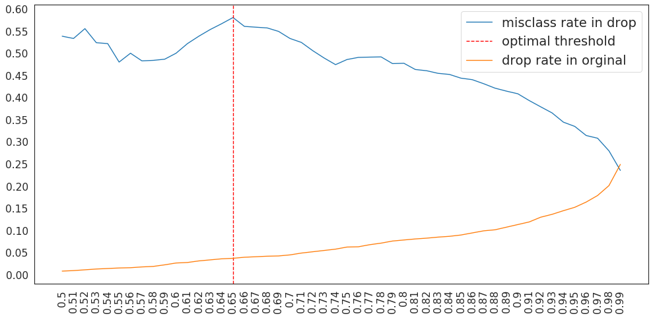
Single Source Wi-Fi based Localization
Adaptive Thresholded & Stacked Voting Scheme
i. Adaptive Thresholded ii. Stacked Voting
２０
Notes:
In order to improve localization performance of proposed model, two optimization meth-
ods are researched in this section. The Softmax activation function is frequently used in
neural networks for classification problems. Assume that the incoming signal goes
through the localization model and is correctly classified into location one, with a Softmax
output value of 0.65. Even though the prediction is correct, there are more uncertainty
associated with an output value of 0.65 versus 0.95. Therefore, we proposed an adaptive thresholeded
method for picking the optimal threshold of Softmax value.
Firstly, we introduce the drop rate and misclassification rate. The drop rate indicates the percentage of dropped data regarding to total test data, and the misclassifica-
tion rate refers to the percentage of filtered misclassfied data existing in dropped data. The
grid search method is applied, which enumerates the threshold values from 0.5 to 1 with an
increment rate of 0.01 and computes the corresponding drop rate and misclassification rate.
As we can see, for the test data, at threshold
equals to 0.65, the misclassification rate in dropped date reaches the peak, which means
most of the dropped data are incorrectly classified by the model, and at this threshold we
only drop less than 5 percent test data while improving the performance of the localization
model. In addition, the specific threshold value can be varied depending on the localization
model.
To further improve the performance of the localization model, a stacked voting method
is adopt. The proposed method is defined as follows: In a real application scenario, at time t 1 , the incoming signal is received and processed by the signal analyzer, and a location
is predicted by the localization model. The prediction of signal is marked as p 1 and is
appended into a predefined stack with a specific size. By repeating the previous steps until
the stack is full, the localization model will make one concluded prediction based on the following condition:
if the size of identical prediction is greater than or equals to 2, the localization system
will considers that identical prediction as the current location of the signal receiver, and
clear the stack.
Otherwise, the stacked predictions will be dropped. In other word, the
localization model will make one localization decison every three predictions.

Slide 21
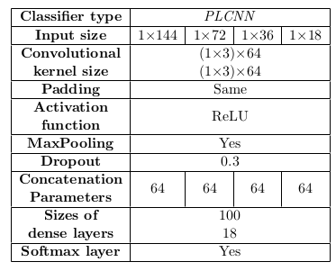
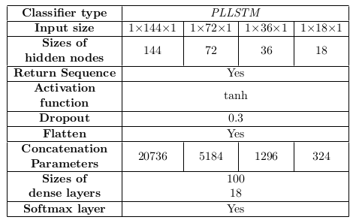
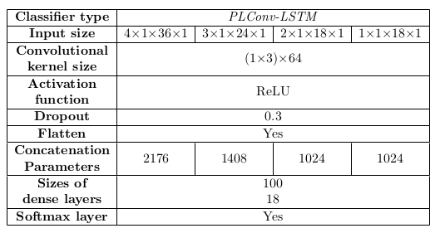
Single Source Wi-Fi based Localization
Evaluation Results
i. Settings for Evaluation .
- Comparison of localization models
- PLCNN
- PLLSTM
- PLConv-LSTM
- Performance with optimization
- Testbed setting
- Intel R Core R i7-9750H CPU @ 2.60GHz
- 23.4 GB RAM @ 2133 MHz
- NIVIDIA GeForce RTX 2060
- Tensorflow 1.13.1
- Keras 2.1.5
２１
Notes:
We evaluate Proposed PLconvLSTM model and another two deep learning based baseline models CNN and vanilla LSTM, to compare the performance.
The evaluation and simulation of the proposed localization model are conducted on a
laptop that is equipped with an Intel R Core R i7-9750H CPU @ 2.60GHz, 23.4 GB RAM
@ 2133 MHz, 1.4 TB SSD and an NIVIDIA GeForce RTX 2060. Tensorflow 1.13.1 Keras
2.1.5 running in Ubuntu 18.04 is used for the model implementation.

Slide 22
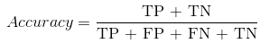
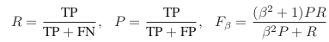
Single Source Wi-Fi based Localization
Evaluation Results
i. Evaluation Metrics.
- Calculate TP, TN, FP, FN for each location, for example location 0
- TP: Assign location 0's signal to location 0
- TN: Assign other locations' signal to other locations
- FP: Assign location 0's signal to other locations
- FN: Assign other locations' signal to location 0
２２
Notes:
Accuracy, Recall, Precision and F measurement score are used as shared metrics to
evaluate the localization models. In the evaluation of the localization performance, for
instance, we define a true positive (TP) decision assigns location 0’s signal to location 0, a
true negative (TN) decision assigns other locations’ signal to other locations. Two types of
mistake are commited, for example, one is the false positive (FP) decision, which assigns
location 0’s signal to other locations. A false negative (FN) decision assigns other locations’
signal to location 0.
To evaluate the localization performance, we let TP be the number of true positive
instances properly classified as X; TN be the number of true negative instances properly
classified as not X; FP be the number of false positive instances classified as X incorrectly;
and FN be the number of false negative instances classified as not X incorrectly. The
evaluation metrics are formulated as follows:
where β > 1 can be used as the penalty factor to provide more weight to recall, and β = 1
is adopt in this thesis.

Slide 23
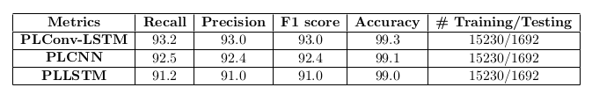
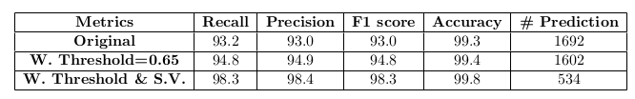
Single Source Wi-Fi based Localization
Evaluation Results
i. Experimental Results
- Performance of designed localization models
- Performance of PLConv-LSTM with optimization
２３
Notes:
We split the datasets into 90% training set and 10% testing set, and the performance
of localization models are based on the testing results. As shown in Table. 4.4, all of these
models achieve excellent results in Accuracy performance. When it comes to other metrics
such Recall, Precision and F1 score, the PLLSTM model provides good results but are
relatively low comparing to PLCNN model. The reason might be of the data has obscure
latent temporal but obvious spatial features. It is also noted that the propsed PLConv-
LSTM outperforms baseline models by up to 2% regarding those metrics, which verifies that
the extra latent genralized spatio-temporal features are captured by such model. In addition,
the performance of PLConv-LSTM with adaptive thresholed and stacked voting prediction
strategy is concluded in Table. 4.5. As it can be seen, since the Accuracy performance
has already reached a high level, the improvement on Accuracy is not easily perceived.
With the optimal pre-defined threshold 0.65, all other metrics increase around 2% and
only 90 datasets are dropped, which proves that the adaptive thresholded method can
considerably improve the performance of localization model without dropping too much
data. In addition, with the involvement of stacked voting method, the Recall, Precision,
and F1 score can increase up to 98% based on the optimal threshold, which demostrates
the effectiveness of proposed scheme. However, as a trade-off, the stacked voting method
takes a longer time to make one prediction, which may not be suitable for a few scenarios
that requires fast speed computation. Overall, according to evaluation results, the designed
PLConv-LSTM model is shown that it is the best model to accomplish the localization task.
Also, the adaptive thresholded and stacked voting scheme is proven to boost the accuracy
of localization model depending on the performance trade-off.

Slide 24
Dataset for Path Prediction
LSTM based Path Prediction Model and Evaluation Results
Case Study of Single-source based Wi-Fi Localization for Path Tracing
LSTM based Path Tracking
２４
Notes:
Next, we will get to the last stage, whichb is the case study of LSTM based path tracking .

Slide 25
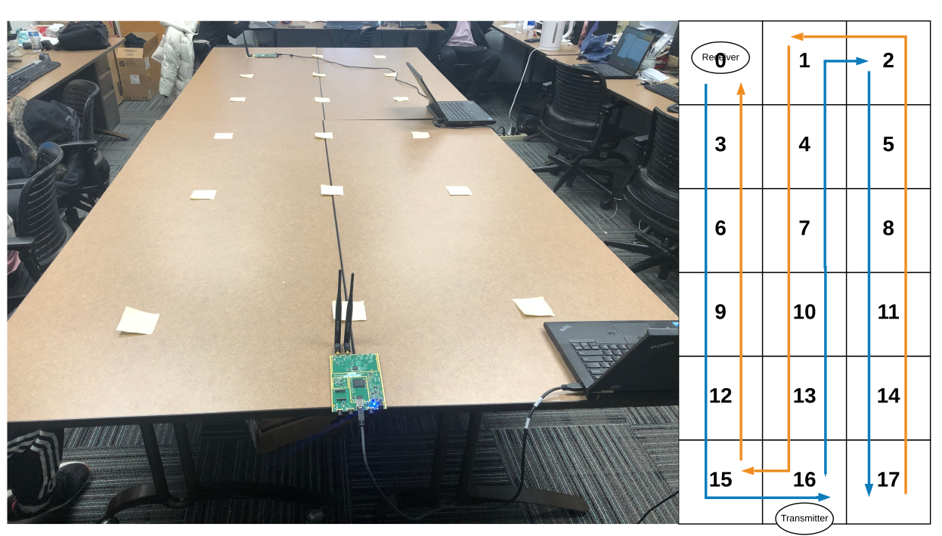
LSTM based Path Tracking
Dataset for Path Prediction
i. Simulated path
0 - 3 - 6 - 9 - 12 .... - 17
17 - 14 - 11 - 8 - 5 - 2
Can be extended by adding other paths
２５
Notes:
The ultimate goal of intelligent indoor localization system is to benefit several practical
applications such as indoor human navigation and robot routing [50, 51]. Thus, in order to
fullfill the proposed localization system, LSTM based path tracking method is proposed to
track and predict the movement of an object.
Without loss of generality, we simulate one forward and one backward paths on the
experimental area shown in Fig. 5.1. It is node that The process can be extended by adding other paths
in a similar way.

Slide 26
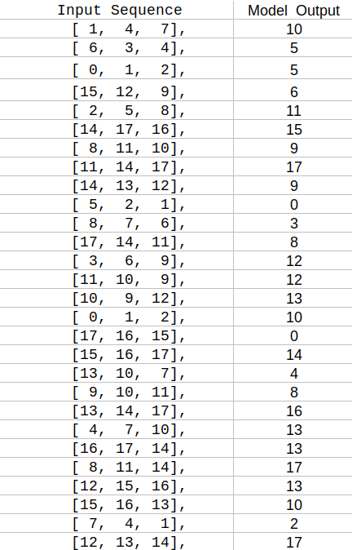
LSTM based Path Tracking
Dataset for Path Prediction
i. Simulated path
0 - 3 - 6 - 9 - 12 .... - 17
17 - 14 - 11 - 8 - 5 - 2
Can be extended by adding other paths
ii. [0, 3, 6] - [9],
[17, 14, 11] - [8]
２６
Notes:
For each simulated path, we consider the prior three sequential locations of simulated
paths as an input sequence and the next location as an output. For instance, in simulated
path one, the next location of input sequence ‘3’, ‘6’, ‘9’ is ‘12’. Thus one dataset is formed
with input sequence [3, 6, 9] and output [12]. Similarly, for simulated path two, the first
dataset can be formed as [17, 14, 11] corresponding to the output [8]. By following the same
rule, 32 training datasets are made up iteratively based on the proposed paths, as shown

Slide 27
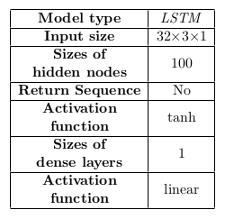
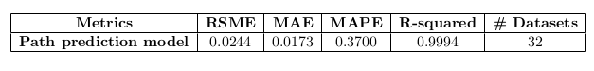
LSTM based Path Tracking
LSTM based Path Prediction Model and Evaluation Results
i. vanila LSTM
ii. RSME, MAE, MAPE lower is better
iii. R-squared close to 1
２７
Notes:
Based on the size of datasets and the characteristic of LSTM networks, the proposed
path prediction model uses vanila LSTM as its main structure in this work, the details of
the model are concluded in the table. Since the database of prediction model is relatively small, we set the hidden nodes of
LSTM network to be 100. One single hidden state for the input sequence with 3 time
steps is output by setting the return sequence of LSTM network to ‘False’. The output
is activated by ‘tanh’ activation function and feed into the dense layer with an activation
function ‘linear’. The constructed time sequential model is able to predict the next location,
given the sequence of prior three locations. In order to evaluate the path prediction model, we consider three different evaluation
metrics: Root Sqaure Mean Error (RSME), Mean Absolute Error (MAE), Mean Absolute Percentage Error (MAPE), and R-squared. The evaluation results are shown in Table.
All metrics indicates how well the datasets fit the prediction model.
As we can see from the table, The RSME and MAE of prediction model are really low,
which shows that the prediction error of the model is small. In addition, MAPE value
is at 0.37% and R-squared is close to 1, which means that the prediction model reaches
perfectness through the training process.

Slide 28
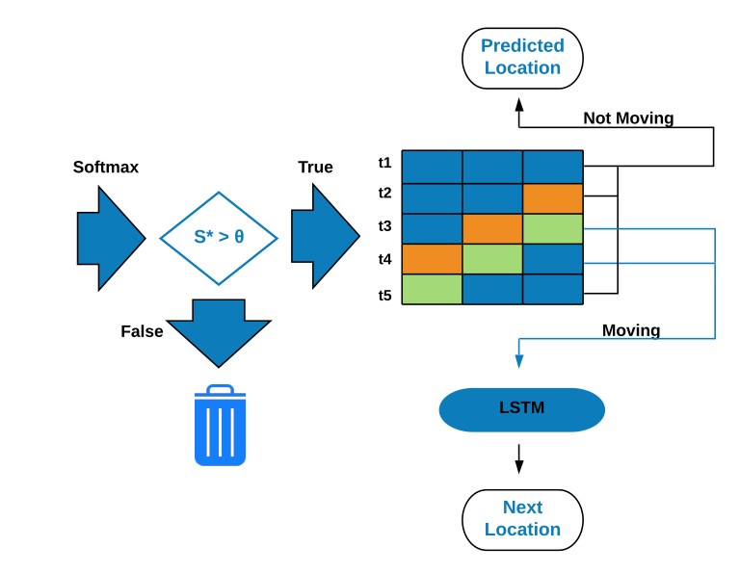
LSTM based Path Tracking
Case Study of Single-source based Wi-Fi Localization for Path Tracing
i. first in first out
ii. size of identical prediction greater than 2 - not moving - output location
iii. three different predictions - moving - pre-trained LSTM - next location
２８
Notes:
By using the LSTM based path prediction model, as a basis, we further introduce
a case study of path tracing scheme regarding proposed Wi-Fi based indoor localization
system. The scheme is designed to predict the sequential movement of the signal receiver.
The study is mainly based on the accuracy of adaptive thresholed prediction since the
prediction speed is the first concern when it comes to the path tracing. The scheme for
path tracing is described as follows: Similar to the stacked voting method, the localization
system will create data structure called “queue”, which has an unique feature called “First
In First Out”. For instance, queue is performing as any queue of consumers for a item
where the consumer that came first is served first. When it comes to proposed localization
system, three predictions are made correponding to first three incoming signals, and they
are appended into the queue. Following the rule of stacked voting method, if the size of
identical prediction is greater than or equals to 2, the system will output that location. The
difference is that when three predictions are different from each other, they will be used as
an input to our pre-trained LSTM based path prediction model. The output of the path
prediction model is the predicted next possible location of the signal receiver. When the
next signal comes in, the queue will pop out the first or the very left location prediction and
append the new prediction to the last or the very right, which ensure smoothing running
of the localization system.

Slide 29
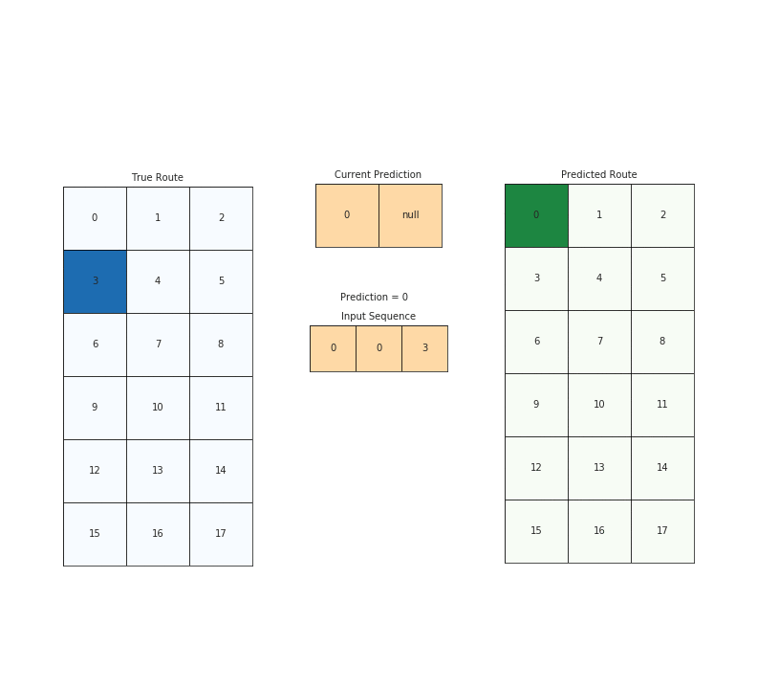
LSTM based Path Tracking
Case Study of Single-source based Wi-Fi Localization for Path Tracing
ii. Demo
forward path: 0:2, 3:2, 6:2, 9:1, 12:1, 15:2,
16:1, 13:2, 10:1, 7:2, 4:1, 1:2,
2:1, 5:2, 8:2, 11:1, 14:1, 17:2
backward path: 17:4, 14:2, 11:4, 8:2, 5:1, 2:2,
1:10, 4:4, 7:1, 10:2, 13:4, 16:1,
15:1, 12:2, 9:2, 6:1, 3:8, 0:8
２９
Notes:
To evaluate the feasiblity of the proposed path tracing scheme, we randomly pick dataset
from localization fingerprints database that follows the simulated path. To automate the process of randomly selecting datasets, simulating the
path, and visualizing the routing, we develop an application that helps avoid the repeated
operations. The demo is shown here.

Slide 30
Conclusion and Future Work
Conclusion：
The proposed Multimodal Learning and Single Source Wi-Fi based Indoor Localization
system can efficiently solve the database construction and adaption problem that current
indoor localization technologies are encountering, and can perform more effectively and
require lower cost than other localization system.
Automating the indoor localization system is highly expected for the furture.
Future work :
Complete the self-driven signal recevier to demostrate the working system.
Add more features to localization fingerprints such as CSI, which may further improve the performance of the system.
Optimize and improve the current methodology such as position estimation technology to increase the efficiency of current system.
３０
Notes:
In this paper, we studied the problems of current fingerprint indoor localization tech-
nologies. Firstly, we proposed a self-update scheme to automatically update the fingerprint
database and localization model with ease. Secondly, we also proposed a signle point Wi-Fi
source based localization model that effectively classify the signal location while reducing
the setup cost to a relatively low level. Lastly, the case study of LSTM based path track-
ing succesfully routing the device within an indoor environment, which is beneficial to the
development of intelligent localization and inspires researchers to explore. Althogh the self-
driven signal receiver has not completed yet, the evaluation result prove the feasiblity of the
autonomous system. In addition, the effectiveness and robustness of propsed localization
model has been evaluted.

Slide 31
References
[1] N. Bulusu, J. Heidemann, and D. Estrin, “Gps-less low-cost outdoor localization for very small devices,” IEEE Personal Communications, vol. 7, no. 5, pp. 28–34, 2000.
[2] F. Zafari, A. Gkelias, and K. K. Leung, “A survey of indoor localization systems and technologies,” IEEE Communications Surveys & Tutorials, vol. 21, no. 3, pp. 2568–2599, 2019.
[3] A. Hameed and H. A. Ahmed, “Survey on indoor positioning applications based on different technologies,” in 2018 12th International Conference on Mathematics, Actuarial Science, Computer Science and Statistics (MACS), 2018, pp. 1–5.
[4] R. Machhamer, M. Dziubany, L. Czenkusch, H. Laux, A. Schmeink, K. Gollmer, S. Naumann, and G. Dartmann, “Online offline learning for sound-based indoor localization using low-cost hardware,” IEEE Access, vol. 7, pp. 155 088–155 106, 2019.
[5] E. Hatem, B. El-Hassan, J. Laheurte, S. Abou-Chakra, E. Colin, and C. Marechal, “Study the estimated distance error in indoor localization using uhf-rfid,” in 2018 IEEE Middle East and North Africa Communications Conference (MENACOMM), 2018, pp. 1–5.
[6] H. Zhou-guo, L. Fang, and Y. Yi, “An improved indoor uhf rfid localization method based on deviation correction,” in 2017 4th International Conference on Information Science and Control Engineering (ICISCE), July 2017, pp. 1401–1404.
[7] T. A. Heya, S. E. Arefin, A. Chakrabarty, and M. Alam, “Image processing based indoor localization system for assisting visually impaired people,” in 2018 Ubiquitous Positioning, Indoor Navigation and Location-Based Services (UPINLBS), March 2018,
pp. 1–7.
And More.
３１

Slide 32
Thank You!
Hongyu Wu
Department of Electrical & Computer Engineering
University of Dayton
Email: wuh007@udayton.edu
３２

